Slide 1
Chapter 1
The Nature of Econometrics and Economic Data

Slide 2
The Nature of Econometrics and Economic Data (1 of 22)
What is econometrics?
Econometrics is the use of statistical methods to analyze economic data.
Econometricians typically analyze nonexperimental data.
Typical goals of econometric analysis:
Estimating relationships between economic variables.
Testing economic theories and hypotheses.
Evaluating and implementing government and business policy.
Common applications
Forecasting macroeconomic variables (interest rates, inflation rates, GDP).
Forecasting non-macro variables (less visible).

Slide 3
The Nature of Econometrics and Economic Data (2 of 22)
Steps in econometric analysis
1) Economic model (this step is often skipped)
2) Econometric model
Economic models
Maybe micro- or macromodels
Often use optimizing behaviour, equilibrium modeling, …
Establish relationships between economic variables
Examples: demand equations, pricing equations, …

Slide 4
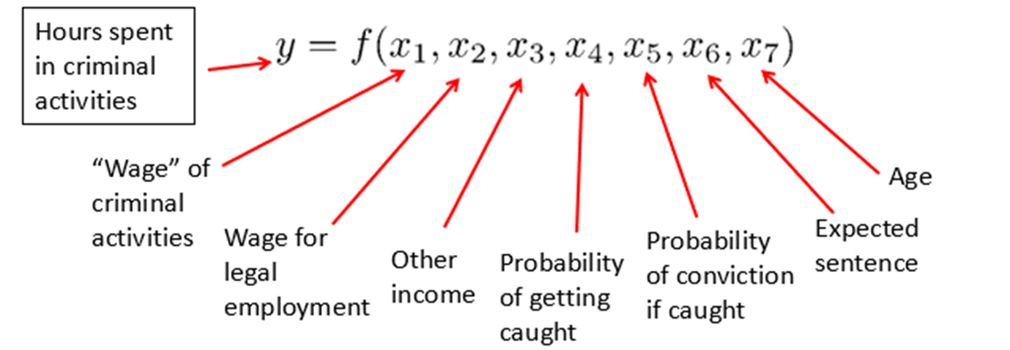
The Nature of Econometrics and Economic Data (3 of 22)
Economic model of crime (Becker (1968))
Derives equation for criminal activity based on utility maximization.
Functional form of relationship not specified.
Equation could have been postulated without economic modeling.

Slide 5
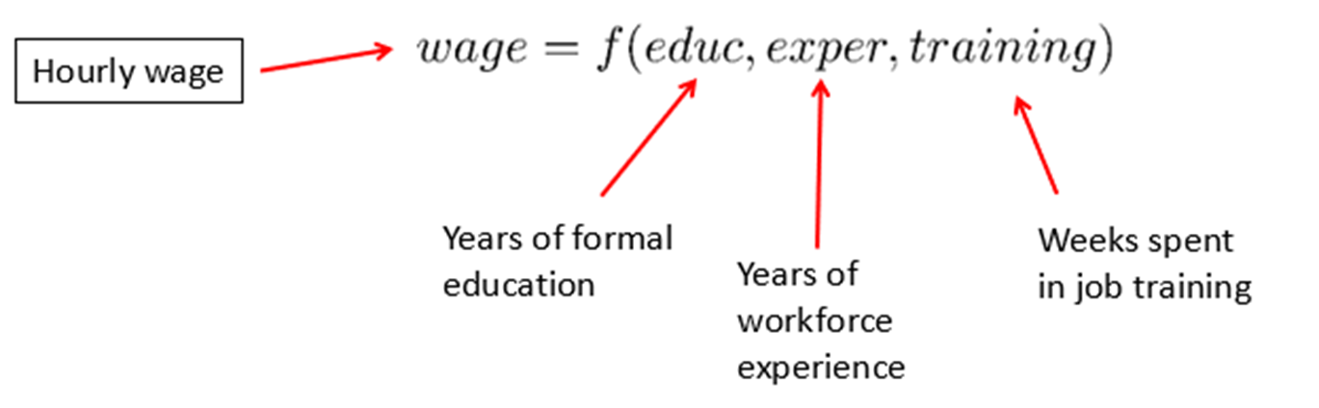
The Nature of Econometrics and Economic Data (4 of 22)
Model of job training and worker productivity
What is the effect of additional training on worker productivity?
Formal economic theory not really needed to derive equation:
Other factors may be relevant, but these are the most important.

Slide 6
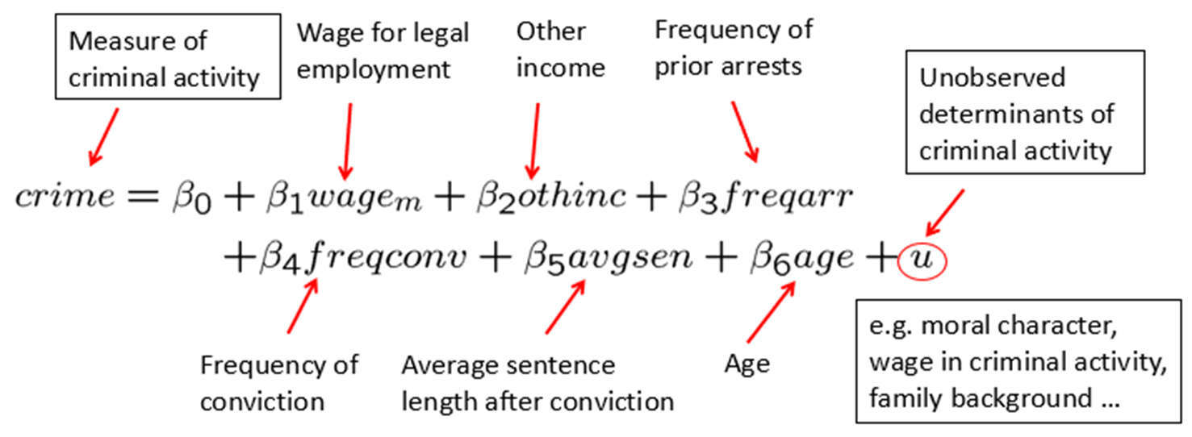
The Nature of Econometrics and Economic Data (5 of 22)
Econometric model of criminal activity
The functional form has to be specified.
Variables may have to be approximated by other quantities.

Slide 7
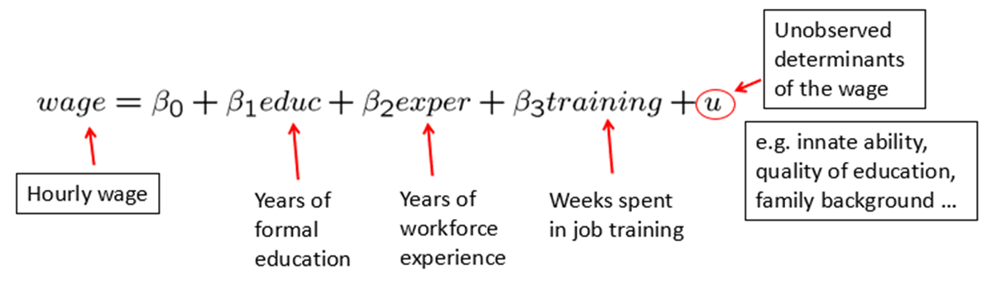
The Nature of Econometrics and Economic Data (6 of 22)
Econometric model of job training and worker productivity
Most of econometrics deals with the specification of the error u.
Econometric models may be used for hypothesis testing.
For example, the parameter β₃ represents the effect of training on wages.
How large is this effect? Is it different from zero?

Slide 8
The Nature of Econometrics and Economic Data (7 of 22)
Econometric analysis requires data.
There are several different kinds of economic data sets:
Cross-sectional data
Time series data
Pooled cross sections
Panel/Longitudinal data
Econometric methods depend on the nature of the data used.
Use of inappropriate methods may lead to misleading results.

Slide 9
The Nature of Econometrics and Economic Data (8 of 22)
Cross-sectional data sets
These may include samples of individuals, households, firms, cities, states, countries, or other units of interest at a given point of time or in a given period.
Cross-sectional observations are more or less independent.
An example is pure random sampling from a population.
Sometimes pure random sampling is violated, for example, people refuse to respond in surveys, or sampling may be characterized by clustering.
Cross-sectional data is typically encountered in applied microeconomics.

Slide 10
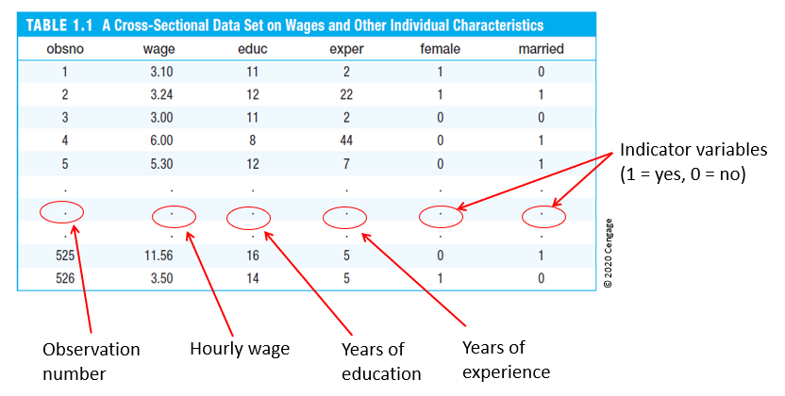
The Nature of Econometrics and Economic Data (9 of 22)
Table 1.1: Cross-sectional data set on wages and other characteristics
obsno | wage | educ | exper | female | married
1 | 3.10 | 11 | 2 | 1 | 0
2 | 3.24 | 12 | 22 | 1 | 1
3 | 3.00 | 11 | 2 | 0 | 0
4 | 6.00 | 8 | 44 | 0 | 1
5 | 5.30 | 12 | 7 | 0 | 1
. | . | . | . | . | .
. | . | . | . | . | .
. | . | . | . | . | .
525 | 11.56 | 16 | 5 | 0 | 1
526 | 3.50 | 14 | 5 | 1 | 0

Slide 11
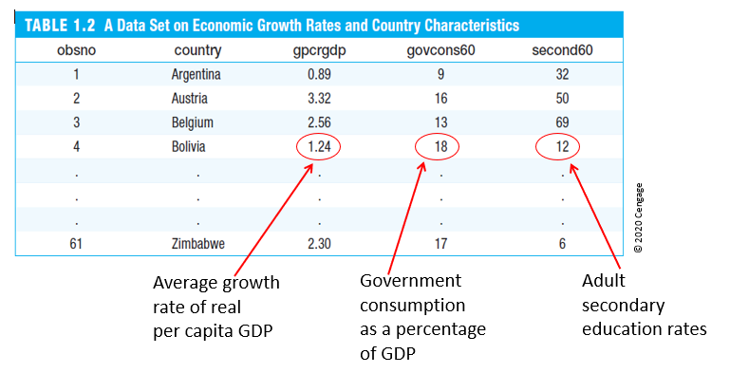
The Nature of Econometrics and Economic Data (10 of 22)
Table 1.2: Cross-sectional data on growth rates and country characteristics
obsno | country | gpcrgdp | govcons60 | second60
1 | Argentina | 0.89 | 9 | 32
2 | Austria | 3.32 | 16 | 50
3 | Belgium | 2.56 | 13 | 69
4 | Bolivia | 1.24 | 18 | 12
. | . | . | . | .
. | . | . | . | .
. | . | . | . | .
61 | Zimbabwe | 2.30 | 17 | 6

Slide 12
The Nature of Econometrics and Economic Data (11 of 22)
Time series data
This includes observations of a variable or several variables over time.
Examples include stock prices, money supply, consumer price index, gross domestic product, annual homicide rates, automobile sales, and so on.
Time series observations are typically serially correlated.
Ordering of observations conveys important information.
Data frequency may include daily, weekly, monthly, quarterly, annually, and so on.
Typical features of time series include trends and seasonality.
Typical applications include applied macroeconomics and finance.

Slide 13
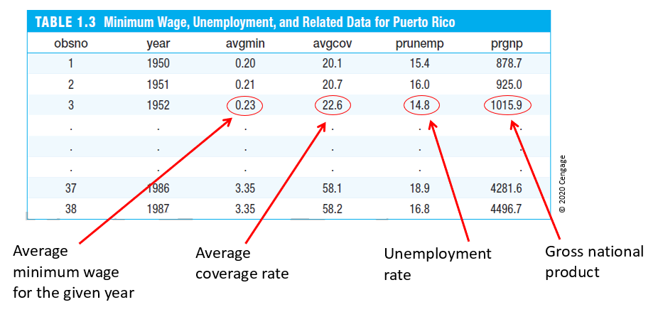
The Nature of Econometrics and Economic Data (12 of 22)
Table 1.3: Time series data on minimum wage, unemployment, and related data for Puerto Rico
obsno | year | avgmin | avgcov | prunemp | prgnp
1 | 1950 | 0.20 | 20.1 | 15.4 | 878.7
2 | 1951 | 0.21 | 20.7 | 16.0 | 925.0
3 | 1952 | 0.23 | 22.6 | 14.8 | 1015.9
. | . | . | . | . | .
. | . | . | . | . | .
. | . | . | . | . | .
37 | 1986 | 3.35 | 58.1 | 18.9 | 4281.6
38 | 1987 | 3.35 | 58.2 | 16.8 | 4496.7

Slide 14
The Nature of Econometrics and Economic Data (13 of 22)
Pooled cross sections
Two or more cross sections are combined in one data set.
Cross sections are drawn independently of each other.
Pooled cross sections are often used to evaluate policy changes.
Example:
Evaluating effect of change in property taxes on house prices.
Random sample of house prices for the year 1993.
A new random sample of house prices for the year 1995.
Compare before/after (1993: before reform, 1995: after reform).

Slide 15
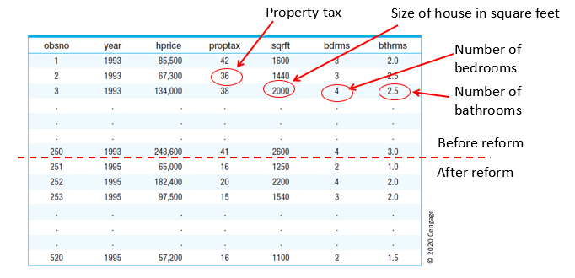
The Nature of Econometrics and Economic Data (14 of 22)
Table 1.4: Pooled cross sections on two years of housing prices
obsno | year | hprice | proptax | sqrft | bdrms | bthrms
1 | 1993 | 85,500 | 42 | 1600 | 3 | 2
2 | 1993 | 67,300 | 36 | 1440 | 3 | 2
3 | 1993 | 134,000 | 38 | 2000 | 4 | 2
. | . | . | . | . | . | .
. | . | . | . | . | . | .
. | . | . | . | . | . | .
250 | 1993 | 243,600 | 41 | 2600 | 4 | 3
251 | 1995 | 65,000 | 16 | 1250 | 2 | 1
252 | 1995 | 182,400 | 20 | 2200 | 4 | 2
253 | 1995 | 97,500 | 15 | 1540 | 3 | 2
. | . | . | . | . | . | .
. | . | . | . | . | . | .
. | . | . | . | . | . | .
520 | 1995 | 57,200 | 16 | 1100 | 2 | 1

Slide 16
The Nature of Econometrics and Economic Data (15 of 22)
Panel or longitudinal data
The same cross-sectional units are followed over time.
Panel data have a cross-sectional and a time series dimension.
Panel data can be used to account for time-invariant unobservables.
Panel data can be used to model lagged responses.
Example:
City crime statistics; each city is observed in two years.
Time-invariant unobserved city characteristics may be modeled.
Effect of police on crime rates may exhibit time lag.

Slide 17
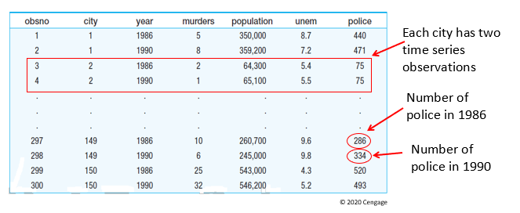
The Nature of Econometrics and Economic Data (16 of 22)
Table 1.5: Two-year panel data set on city crime statistics
obsno | city | year | murders | population | unem | police
1 | 1 | 1986 | 5 | 350,000 | 8.7 | 440
2 | 1 | 1990 | 8 | 359,200 | 7.2 | 471
3 | 2 | 1986 | 2 | 64,300 | 5.4 | 75
4 | 2 | 1990 | 1 | 65,100 | 5.5 | 75
. | . | . | . | . | . | .
. | . | . | . | . | . | .
. | . | . | . | . | . | .
297 | 149 | 1986 | 10 | 260,700 | 9.6 | 286
298 | 149 | 1990 | 6 | 245,000 | 9.8 | 334
299 | 150 | 1986 | 25 | 543,000 | 4.3 | 520
300 | 150 | 1990 | 32 | 546,200 | 5.2 | 493

Slide 18
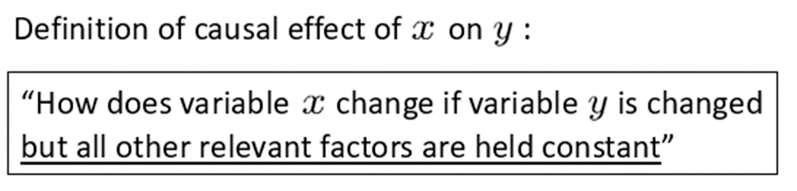
The Nature of Econometrics and Economic Data (17 of 22)
Causality and the notion of ceteris paribus
Ceteris paribus: “other relevant factors being equal.”
Most economic questions are ceteris paribus questions.
It is important to define which causal effect one is interested in.
It is useful to describe how an experiment would have to be designed to infer the causal effect in question.

Slide 19
The Nature of Econometrics and Economic Data (18 of 22)
Causal effect of fertilizer on crop yield
“By how much will the production of soybeans increase if one increases the amount of fertilizer applied to the ground.”
Implicit assumption: all other factors that influence crop yield such as quality of land, rainfall, presence of parasites, and so on are held fixed.
Experiment = Feasible
Choose several one-acre plots of land; randomly assign different amounts of fertilizer to the different plots; compare yields.
Experiment works because amount of fertilizer applied is unrelated to other factors influencing crop yields.

Slide 20
The Nature of Econometrics and Economic Data (19 of 22)
Measuring the return to education
“If a person is chosen from the population and given another year of education, by how much will his or her wage increase?”
Implicit assumption: all other factors that influence wages such as experience, family background, intelligence, and so on are held fixed.
Experiment ≠ Infeasable
Choose a group of people; randomly assign different amounts of education to them (infeasable!); compare wage outcomes.
Problem without random assignment, amount of education is related to other factors that influence wages (e.g. intelligence).

Slide 21
The Nature of Econometrics and Economic Data (20 of 22)
Effect of law enforcement on city crime level
“If a city is randomly chosen and given ten additional police officers, by how much would its crime rate fall?”
Alternatively: “If two cities are the same in all respects, except that city A has ten more police officers than city B, by how much would the two cities’ crime rates differ?”
Experiment ≠ Infeasable
Randomly assign number of police officers to a large number of cities (virtually impossible, as no two cities are alike in all respects except size of police force!).
More importantly, in reality, the number of police officers occurs contemoraneously with determination of crime rate.

Slide 22
The Nature of Econometrics and Economic Data (21 of 22)
Effect of the minimum wage on unemployment
“By how much (if at all) will unemployment increase if the minimum wage is increased by a certain amount (holding other things fixed)?”
Experiment ≠ Infeasable
Government randomly chooses minimum wage each year and observes unemployment outcomes.
Experiment would theoretically work because level of minimum wage is unrelated to other factors determining unemployment.
In reality, the level of the minimum wage will depend on political and economic factors that also influence unemployment.

Slide 23
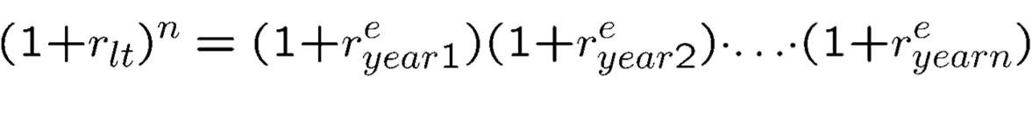
The Nature of Econometrics and Economic Data (22 of 22)
Testing predictions of economic theories
Economic theories are not always stated in terms of causal effects.
For example, the expectations hypothesis states that long-term interest rates equal compounded expected short-term interest rates.
An implicaton is that the interest rate of a three-month T-bill should be equal to the expected interest rate for the first three months of a six-month T-bill; this can be tested using econometric methods.

